Slide 1

Student Details :
Name: Kunal Jolly Saxena
SkillsBuild Email ID: Kunaljollysa@gmail.com
College Name: Madhav Institute of Technology and Science
College State: Madhya Pradesh, India
Internship Domain: Data Analytics
Intership Start and End Date: 12-06-2023 to 24-07-2023

Slide 2
PROJECT TITLE/Problem Statement
Data Analysis of a Super Store Data Set to make profitable decisions.

Slide 3
AGENDA
My agenda is to perform Descriptive Analysis, Sales Analysis, Profit Analysis, Geographic Analysis, And Exploratory Data Analysis of Super store dataset to get experience in the field of data analytics and I want to show case my skills to make useful for the company who is trying to get some profit in its work.

Slide 4
PROJECT OVERVIEW
Purpose:
To get insights and inferences from data set.
Scope:
As we have done analysis of dataset, Now we
are able to get experience of this project.

Slide 5
WHO ARE THE END USERS of this project?
Based on the analysis conducted on the superstore dataset, several stakeholders can benefit from the insights obtained:
Superstore Management:
The management team can use the analysis to identify weak areas and take targeted actions to increase profitability.
Sales and Marketing Teams:
The sales and marketing teams can utilize the analysis to focus their efforts on regions with lower sales and develop targeted marketing campaigns to improve performance.

Slide 6
YOUR SOLUTION AND ITS VALUE PROPOSITION :
Based on the analysis of the superstore dataset, here are some potential solutions and their value propositions:
Improve the profitability of the Furniture category.
Address the loss-making sub-categories, Bookcases and Tables.
Optimize the performance of the Supplies sub-category within Office supplies.
Enhance the profitability of Machines in the Technology category.
Capitalize on the success of profitable sub-categories like Labels, Paper, Envelopes, Furnishings, Copiers, and Accessories.

Slide 7
How did you customize the project and make it your own
"Besides conducting the Exploratory Data Analysis of the dataset, I also delved deeper and uncovered additional insights. I performed a Geographical analysis to identify any location-related problems that could affect customer delivery, product quality, or storage issues. It appears that these specific places might not be generating substantial profits, indicating the need for strategic decision-making based on the data analysis. Taking proactive steps to address these challenges would be crucial in enhancing profitability and ensuring customer satisfaction."

Slide 8
MODELLING:
The modeling techniques utilized for the sales and profit analysis include:
1. Grouping and Aggregation:
- The `groupby()` function from the pandas library is used to group the data based on specific columns
(`City` and `Sub-Category`).
- The `sum()` function is applied to calculate the total sales and profit within each group.
2. Data Visualization:
- The matplotlib and seaborn libraries are employed to create bar plots for visualizing the total sales and profit.
- The `sns.barplot()` function is used to create the bar plots, with the x-axis representing the cities or sub-categories and
the y-axis representing the sales or profit.
- The `plt.figure()`, `plt.title()`, and `plt.xticks()` functions are used to customize the figure size, title, and x-axis labels.
These modeling techniques enable the exploration and visualization of the sales and profit data, providing insights into the performance of different locations and sub-categories. By utilizing technology principles and data analysis tools, such as pandas, matplotlib, and seaborn, the solution leverages data-driven modeling to gain valuable insights for decision-making.

Slide 9
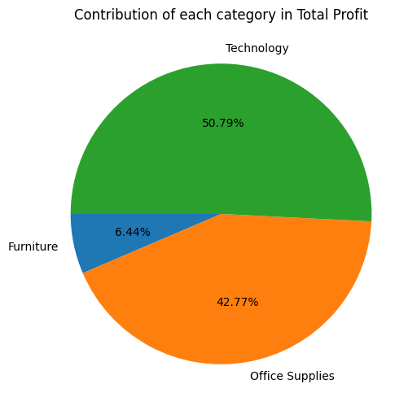
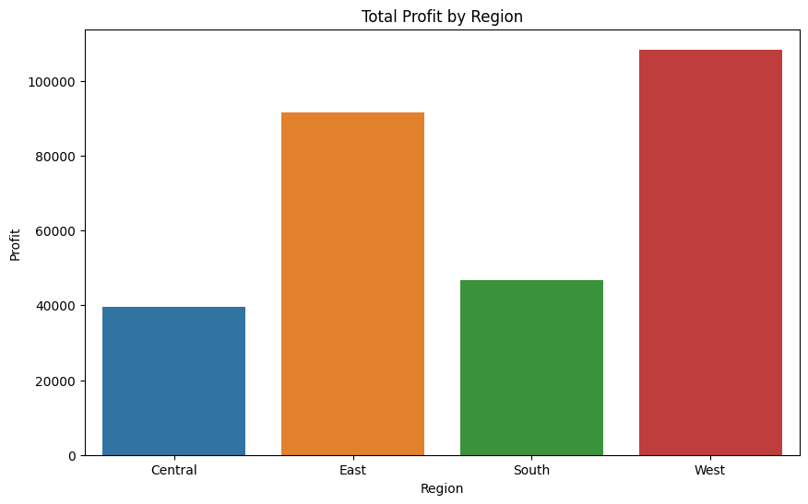
Exploring and plotting of Data:
These numbers clearly indicate that Furniture is not profitable to the expected extent though its overall sales are similar to that of remaining categories.

Slide 10
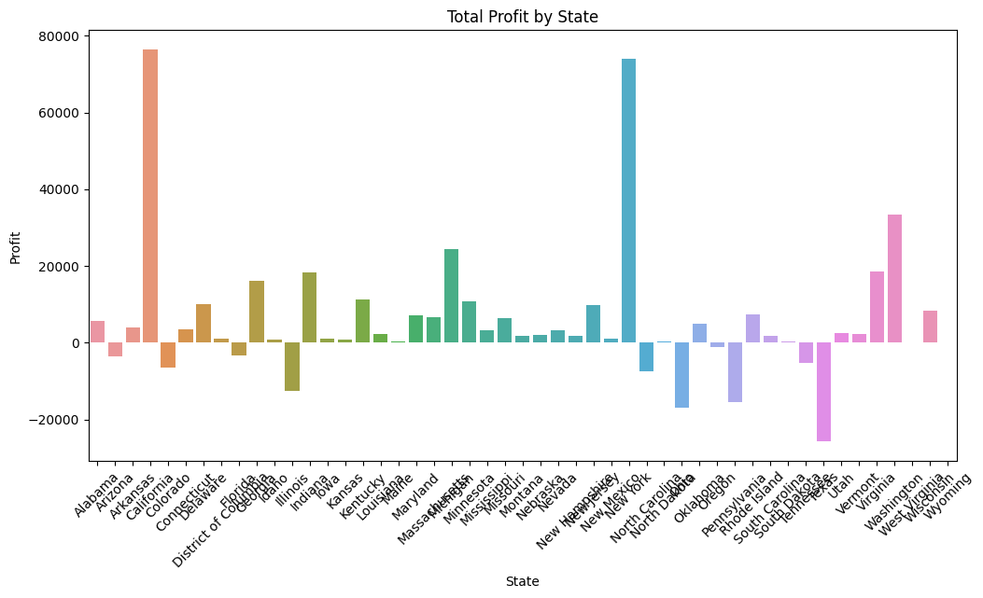
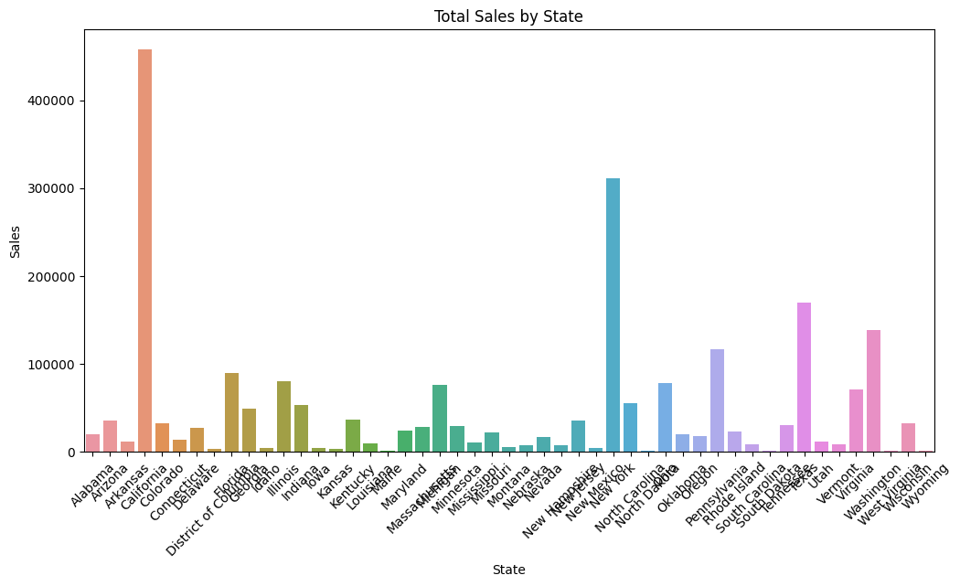
Exploring Sales and Profits in subcategory (Cities) wise:
The profit is unevenly distributed among regions. The sales are comparatively much more higher in East and West regions than the Souths and central regions. If the total sales I West region crosses 1 Lakh, there are only about 40 thousand sales in central region.

Slide 11
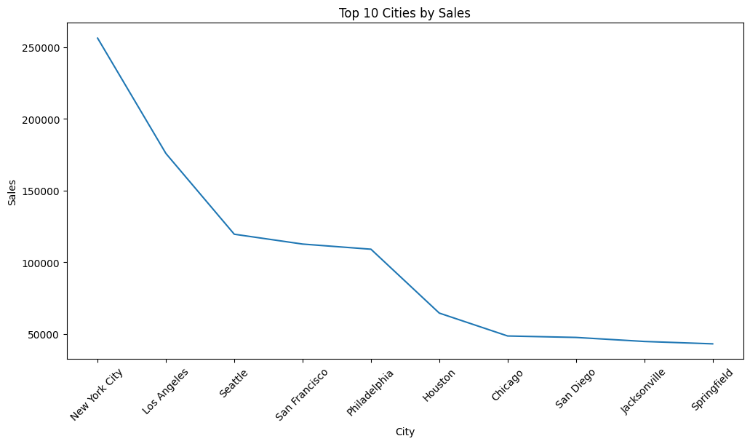
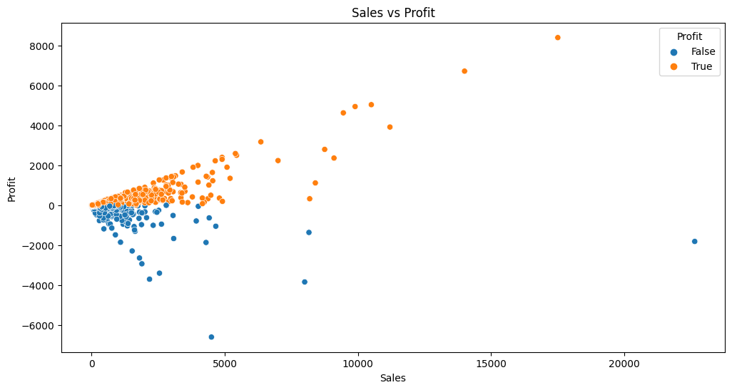
Sales vs Profit Graphs among the Top 10 citites:
In this slide I am trying to get the details of sales with profits of top 10 cities so that It may be helpful to get the relation between Sales and profits to make some useful insights.

Slide 12
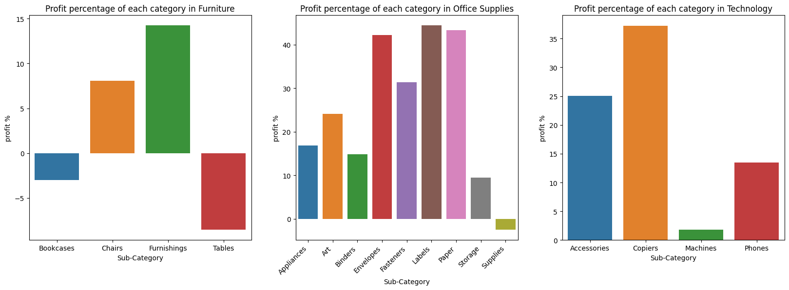
Sub Category wise Comparison of profits:
These plots show that the maximum percentage of profits are coming from office supplies while the loss is occurring majorly due to sub categories of furniture like Bookcases and Tables. Also, Technology is not out of the major contribution factors for profit. In fact, it is the only category where no item is sold at loss.

Slide 13
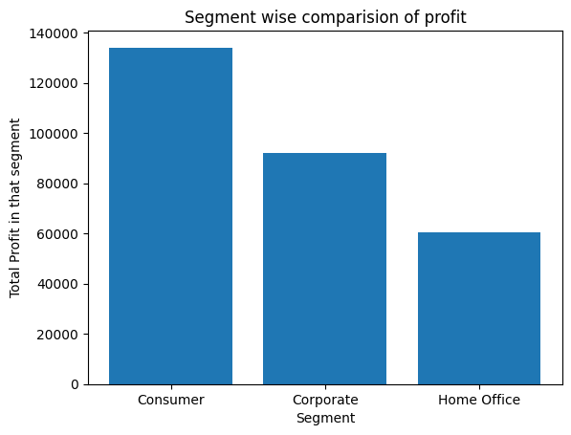
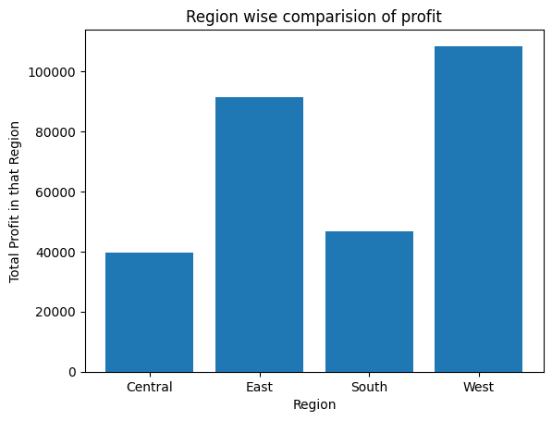
Segment and Region wise distribution of profit:
Consumer segment is the most significant segment in terms of profit. It produces almost 1.5 times the profit of Corporate segment and more than twice of the profit of Home Office.

Slide 14
Results :
After analyzing the data, we have drawn the following conclusions:
1. The superstore's sales are categorized into Consumer, Corporate, and Home supplies across the West, East, Central, and South regions. The products sold fall under Furniture, Office supplies, or Technology.
2. Furniture has the lowest contribution to overall profit, implying the need for focused attention to enhance profitability in this category.
3. Bookcases and Tables sub-categories are generating losses. Options include discontinuing these items or adjusting prices to increase profitability.
4. The Supplies sub-category in Office supplies is experiencing losses, while Machines in Technology are generating minimal profit. Improving manufacturing costs is essential for increased profitability.
5. Labels, Paper, and Envelopes sub-categories are the most profitable in Office supplies, along with Furnishings, Copiers, and Accessories. Maintaining their current state is recommended.
6. Sales in the Central and South regions lag behind the East and West regions. Marketing efforts and shipment process improvements are necessary to boost sales in the latter regions.

Slide 15
Links :
Google Drive link: https://drive.google.com/drive/folders/1mL7fW4t8DPQK75odzfdpwuQiktyR9qlN?usp=sharing
Google Colab link:
https://colab.research.google.com/drive/1o3jMPBMsZaXuL-5-X3HwgNYJLJkk9rKm?usp=sharing
GitHub link:
https://github.com/Kunaljolly/IBM-SkillsBuild-Intership-Data-analytics-project/

